Slide 1
An interesting pair of Simultaneous Equations

Slide 2
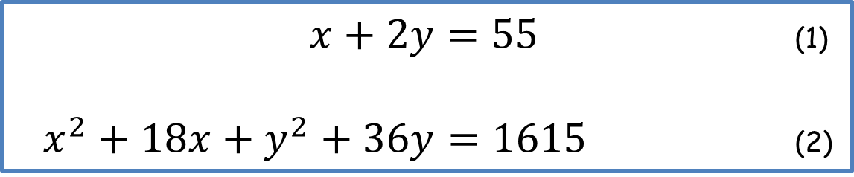

An interesting pair of Simultaneous Equations
Solve the following simultaneous equations:
and
Can you explain your results?
$x+2y=55$ (1)
$x^{2}+18x+y^{2}+36y=1615$ (2)
$x+2y=55$ (1)
$x^{2}−18x+y^{2}−36y=−365$ (3)

Slide 3
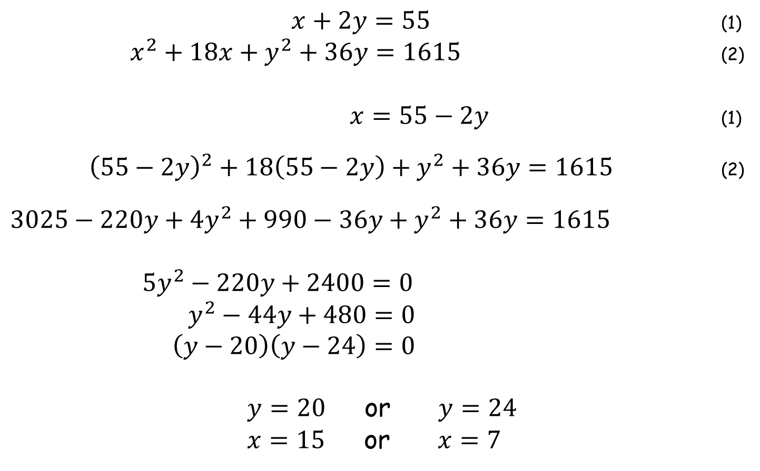
An interesting pair of Simultaneous Equations
$x+2y=55$ (1)
$x^{2}+18x+y^{2}+36y=1615$ (2)
$x=55−2y$ (1)
${\left(55−2y\right)}^{2}+18\left(55−2y\right)+y^{2}+36y=1615$ (2)
$3025−220y+4y^{2}+990−36y+y^{2}+36y=1615$
$5y^{2}−220y+2400=0$
$y^{2}−44y+480=0$
$\left(y−20\right)\left(y−24\right)=0$
$y=20$ or $y=24$
$x=15$ or $x=7$

Slide 4
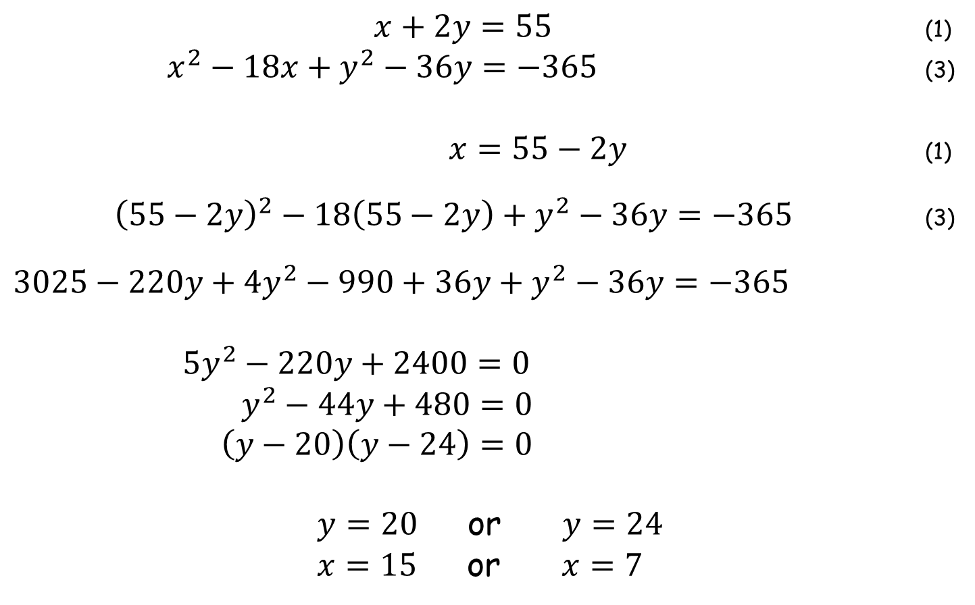
An interesting pair of Simultaneous Equations
$x+2y=55$ (1)
$x^{2}−18x+y^{2}−36y=−365$ (3)
$x=55−2y$ (1)
${\left(55−2y\right)}^{2}−18\left(55−2y\right)+y^{2}−36y=−365$ (3)
$3025−220y+4y^{2}−990+36y+y^{2}−36y=−365$
$5y^{2}−220y+2400=0$
$y^{2}−44y+480=0$
$\left(y−20\right)\left(y−24\right)=0$
$y=20$ or $y=24$
$x=15$ or $x=7$

Slide 5

An interesting pair of Simultaneous Equations
Can you explain your results?
Solution to both is $x=7 , y=24$and $x=15 , y=20$
$x+2y=55$ (1)
$x^{2}+18x+y^{2}+36y=1615$ (2)
$x+2y=55$ (1)
$x^{2}−18x+y^{2}−36y=−365$ (3)

Slide 6
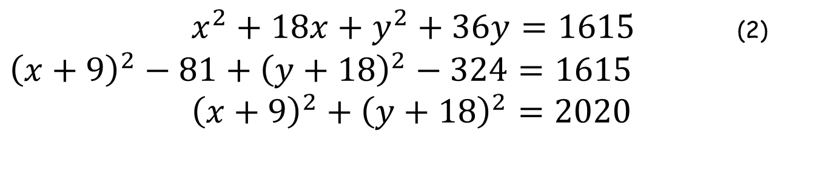
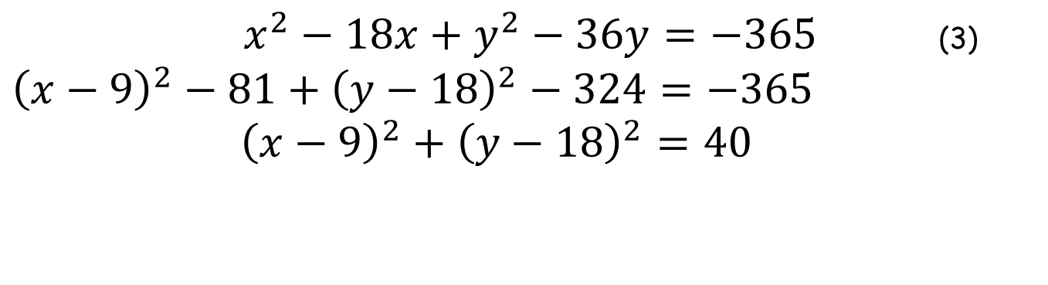
An interesting pair of Simultaneous Equations
Complete the square on equations (2) and (3).
$x^{2}+18x+y^{2}+36y=1615$ (2)
${\left(x+9\right)}^{2}−81+{\left(y+18\right)}^{2}−324=1615$
${\left(x+9\right)}^{2}+{\left(y+18\right)}^{2}=2020$
$x^{2}−18x+y^{2}−36y=−365$ (3)
${\left(x−9\right)}^{2}−81+{\left(y−18\right)}^{2}−324=−365$
${\left(x−9\right)}^{2}+{\left(y−18\right)}^{2}=40$
It is insightful to see these equations plotted on axes…

Slide 7
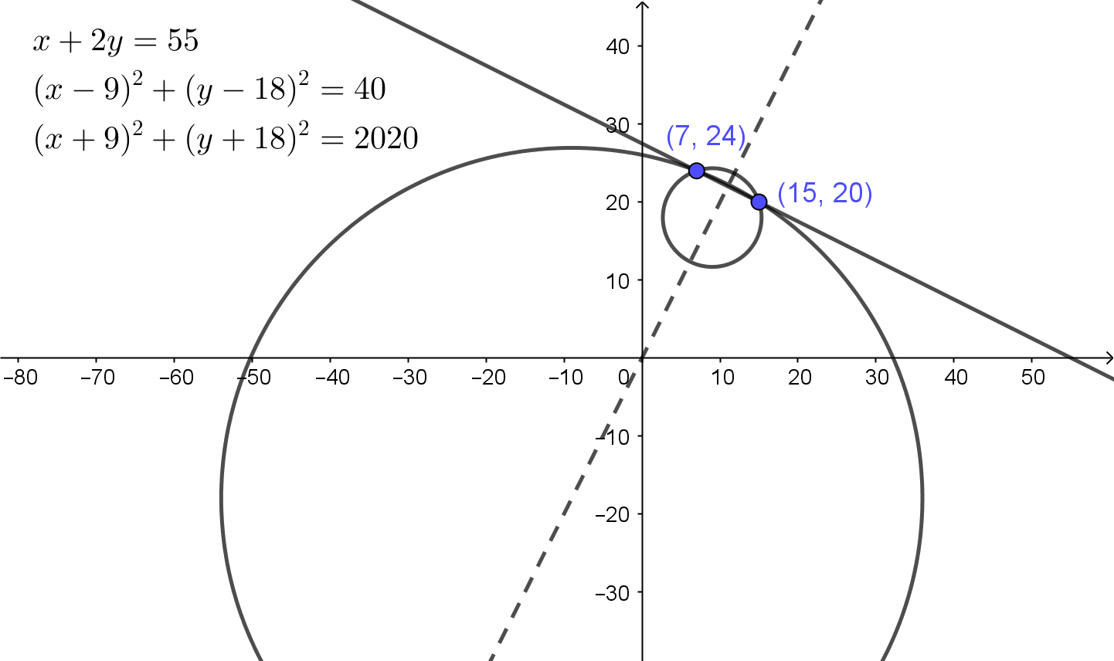
An interesting pair of Simultaneous Equations

Slide 8
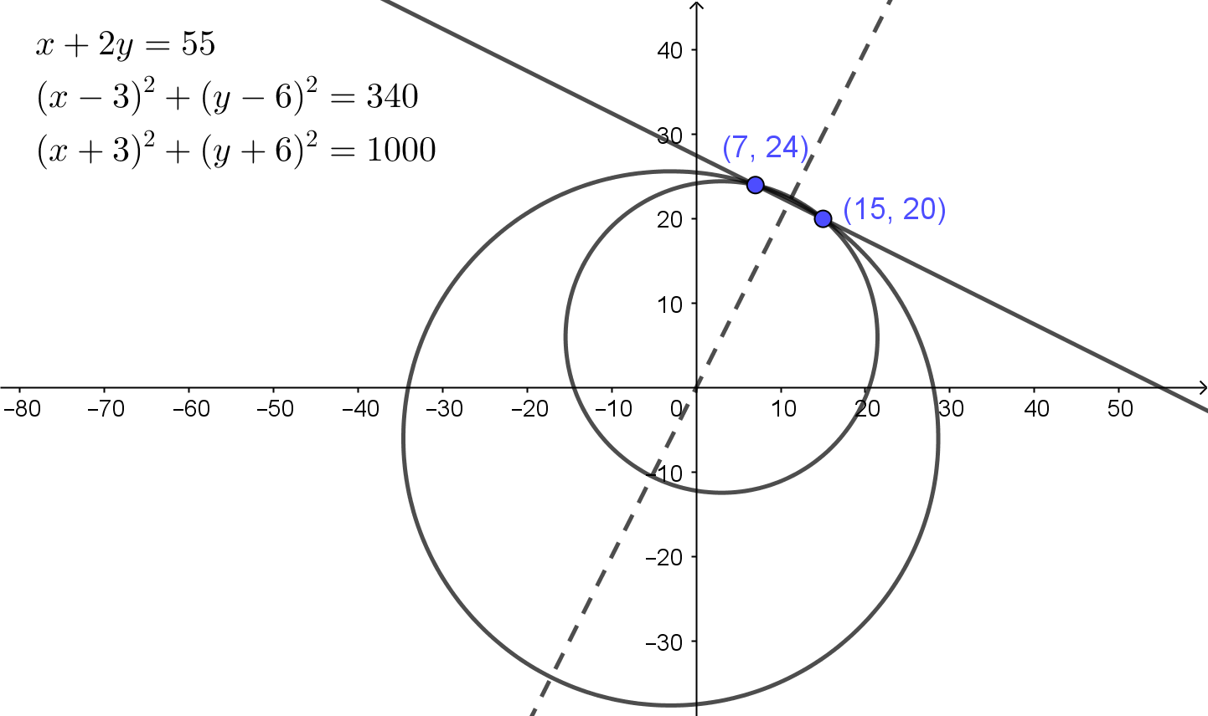
An interesting pair of Simultaneous Equations

Slide 9
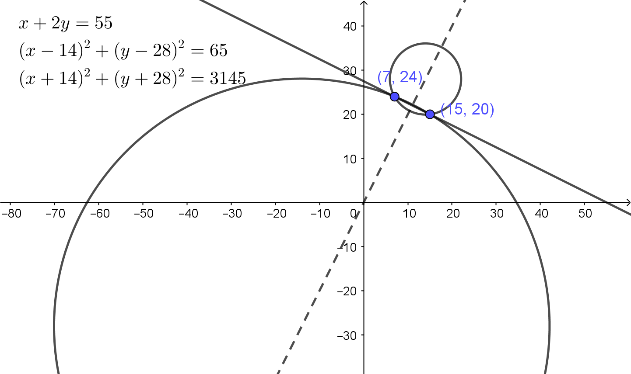
An interesting pair of Simultaneous Equations

Slide 10
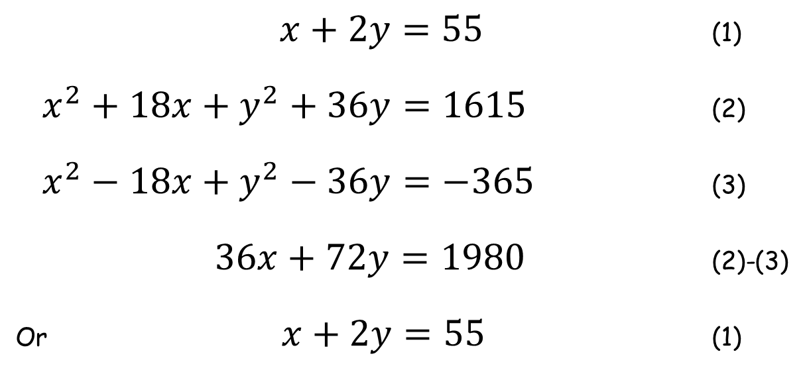
An interesting pair of Simultaneous Equations
Finally, subtract equation (3) from equation (2).
$x+2y=55$ (1)
$x^{2}+18x+y^{2}+36y=1615$ (2)
$x^{2}−18x+y^{2}−36y=−365$ (3)
$36x+72y=1980$ (2)-(3)
Or $x+2y=55$ (1)
Subtracting the equation of a circle from another which is overlapping it yields the equation of the common chord.

Slide 12
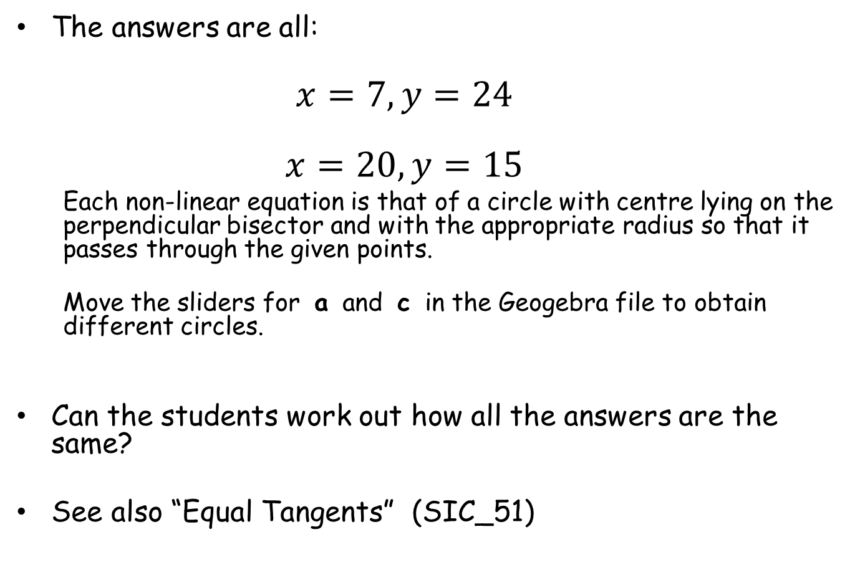
Note to Teacher
The answers are all:
  $$x=7, y=24$$
  $$x=20, y=15$$
  Each non-linear equation is that of a circle with centre lying on the perpendicular bisector and with the appropriate radius so that it passes through the given points.
  Move the sliders for a and c in the Geogebra file to obtain different circles.
Can the students work out how all the answers are the same?
See also “Equal Tangents” (SIC_51)

Slide 13
RESOURCES

Slide 14


SIC_63
An interesting pair of Simultaneous Equations
Solve the following simultaneous equations:
and
Can you explain your results?
$x+2y=55$ (1)
$x^{2}+28x+y^{2}+56y=2165$ (2)
$x+2y=55$ (1)
$x^{2}−28x+y^{2}−56y=−915$ (3)

Slide 15


SIC_63
An interesting pair of Simultaneous Equations
Solve the following simultaneous equations:
and
Can you explain your results?
$x+2y=55$ (1)
$x^{2}+26x+y^{2}+52y=2055$ (2)
$x+2y=55$ (1)
$x^{2}−26x+y^{2}−52y=−805$ (3)

Slide 16


SIC_63
An interesting pair of Simultaneous Equations
Solve the following simultaneous equations:
and
Can you explain your results?
$x+2y=55$ (1)
$x^{2}+24x+y^{2}+48y=1945$ (2)
$x+2y=55$ (1)
$x^{2}−24x+y^{2}−48y=−695$ (3)

Slide 17


SIC_63
An interesting pair of Simultaneous Equations
Solve the following simultaneous equations:
and
Can you explain your results?
$x+2y=55$ (1)
$x^{2}+22x+y^{2}+44y=1835$ (2)
$x+2y=55$ (1)
$x^{2}−22x+y^{2}−44y=−585$ (3)

Slide 18


SIC_63
An interesting pair of Simultaneous Equations
Solve the following simultaneous equations:
and
Can you explain your results?
$x+2y=55$ (1)
$x^{2}+20x+y^{2}+40y=1725$ (2)
$x+2y=55$ (1)
$x^{2}−20x+y^{2}−40y=−475$ (3)

Slide 19
SIC_63
An interesting pair of Simultaneous Equations
Solve the following simultaneous equations:
and
Can you explain your results?
$x+2y=55$ (1)
$x^{2}+18x+y^{2}+36y=1615$ (2)
$x+2y=55$ (1)
$x^{2}−18x+y^{2}−36y=−365$ (3)

Slide 20

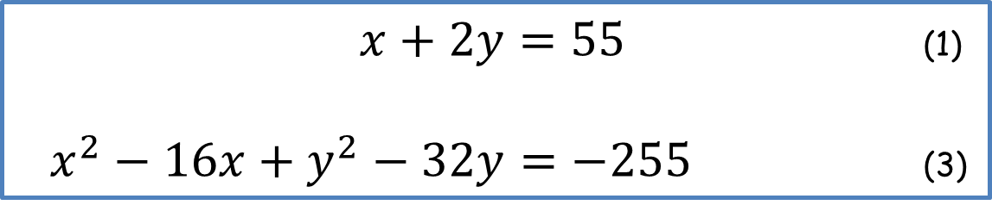
SIC_63
An interesting pair of Simultaneous Equations
Solve the following simultaneous equations:
and
Can you explain your results?
$x+2y=55$ (1)
$x^{2}+16x+y^{2}+32y=1505$ (2)
$x+2y=55$ (1)
$x^{2}−16x+y^{2}−32y=−255$ (3)

Slide 21


SIC_63
An interesting pair of Simultaneous Equations
Solve the following simultaneous equations:
and
Can you explain your results?
$x+2y=55$ (1)
$x^{2}+14x+y^{2}+28y=1395$ (2)
$x+2y=55$ (1)
$x^{2}−14x+y^{2}−28y=−145$ (3)

Slide 22


SIC_63
An interesting pair of Simultaneous Equations
Solve the following simultaneous equations:
and
Can you explain your results?
$x+2y=55$ (1)
$x^{2}+12x+y^{2}+24y=1285$ (2)
$x+2y=55$ (1)
$x^{2}−12x+y^{2}−24y=−35$ (3)

Slide 23


SIC_63
An interesting pair of Simultaneous Equations
Solve the following simultaneous equations:
and
Can you explain your results?
$x+2y=55$ (1)
$x^{2}+10x+y^{2}+20y=1175$ (2)
$x+2y=55$ (1)
$x^{2}−10x+y^{2}−20y=75$ (3)

Slide 24
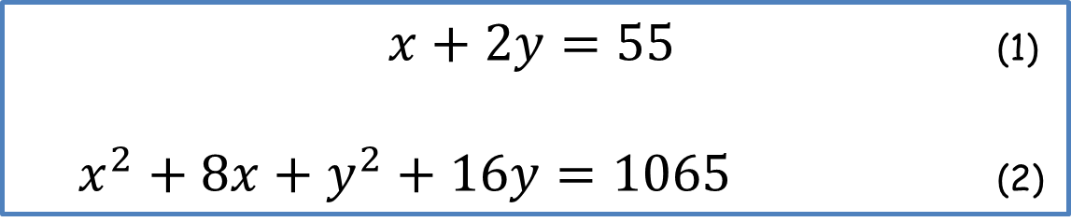

SIC_63
An interesting pair of Simultaneous Equations
Solve the following simultaneous equations:
and
Can you explain your results?
$x+2y=55$ (1)
$x^{2}+8x+y^{2}+16y=1065$ (2)
$x+2y=55$ (1)
$x^{2}−8x+y^{2}−16y=185$ (3)

Slide 25


SIC_63
An interesting pair of Simultaneous Equations
Solve the following simultaneous equations:
and
Can you explain your results?
$x+2y=55$ (1)
$x^{2}+6x+y^{2}+12y=955$ (2)
$x+2y=55$ (1)
$x^{2}−6x+y^{2}−12y=295$ (3)

Slide 26


SIC_63
An interesting pair of Simultaneous Equations
Solve the following simultaneous equations:
and
Can you explain your results?
$x+2y=55$ (1)
$x^{2}+4x+y^{2}+8y=845$ (2)
$x+2y=55$ (1)
$x^{2}−4x+y^{2}−8y=405$ (3)

Slide 27


SIC_63
An interesting pair of Simultaneous Equations
Solve the following simultaneous equations:
and
Can you explain your results?
$x+2y=55$ (1)
$x^{2}+2x+y^{2}+4y=735$ (2)
$x+2y=55$ (1)
$x^{2}−2x+y^{2}−4y=515$ (3)

